Slide 1
Design Review 4
Team 513
Automated Shaft Flux Measurement Device

Slide 2

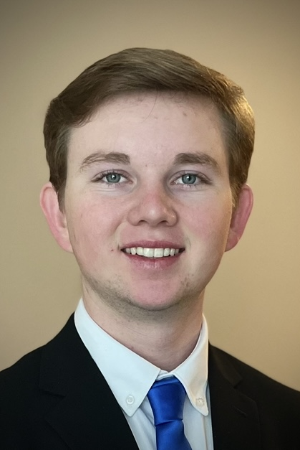

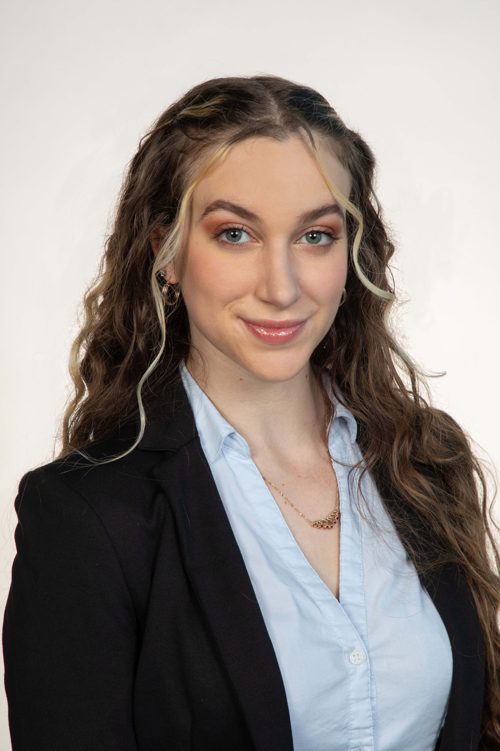
Team Introductions
Joshua Huls
Andrew Atallah
Hardware & Software
Engineer
Sean Hemstreet
Design Engineer
Joshua Huls
Systems Engineer
Liora Louis
Materials &
Test Engineer

Slide 3




Sponsor and Advisor
Joshua Huls
Engineering Mentor
William Bilbow
Director of Technology & Project Manager
Engineering Mentor
Cole Gray
Mechanical Design Engineer
Academic Advisor
Dr. Shayne McConomy
Senior Design Professor

Slide 4
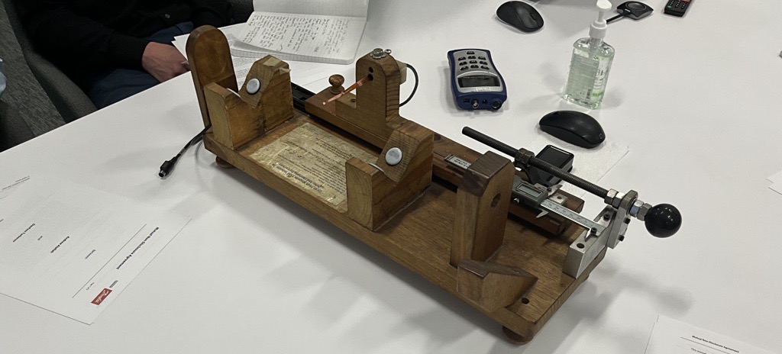
Objective
Joshua Huls
The objective of this project is to design a device that will be capable of fully measuring and recording the magnetic flux of compressor shafts in an automated way that allows for accurate measurements, repeatability, and less overall firsthand work for the operator.

Slide 5




Key Goals
Joshua Huls
Automation
Consistency
Adaptability
Accuracy

Slide 6
Assumptions
Joshua Huls
Device is used over a period of 3 months per year.
MATLAB or an open-source software.
Given one working fluxmeter and sensor.
Testing will be performed at Danfoss.
Operator will be able to lift the shaft onto device.

Slide 7
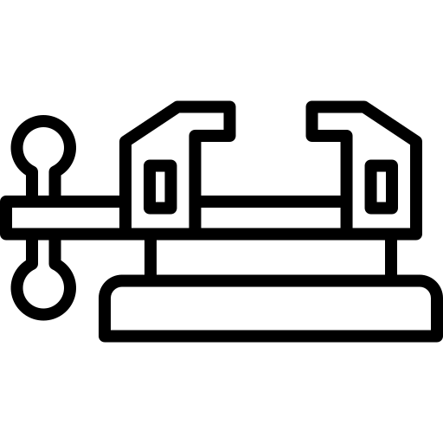




Targets and Metrics
Joshua Huls
Secures Sample
Data Transfer
Repeatability
Resolution (5mm)
Structural Durability

Slide 8

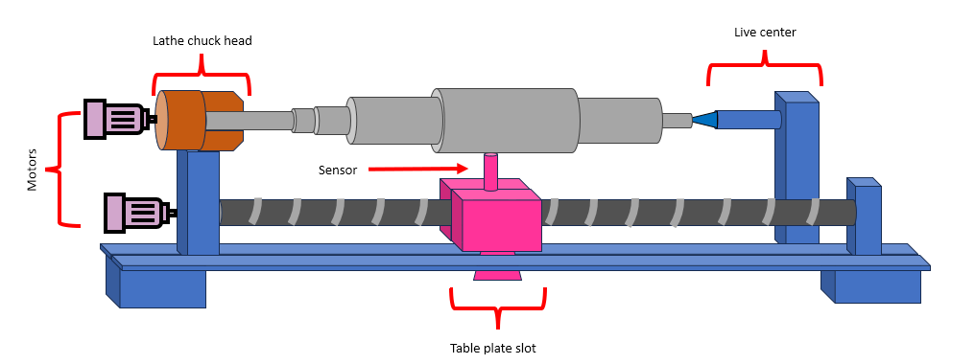


Selected Design
Joshua Huls
Reliable Measurement Feedback
Consistent Measurements
Measures Entire Region
Secures and Levels Samples
Horizontal Lathe
Adaptable

Slide 9
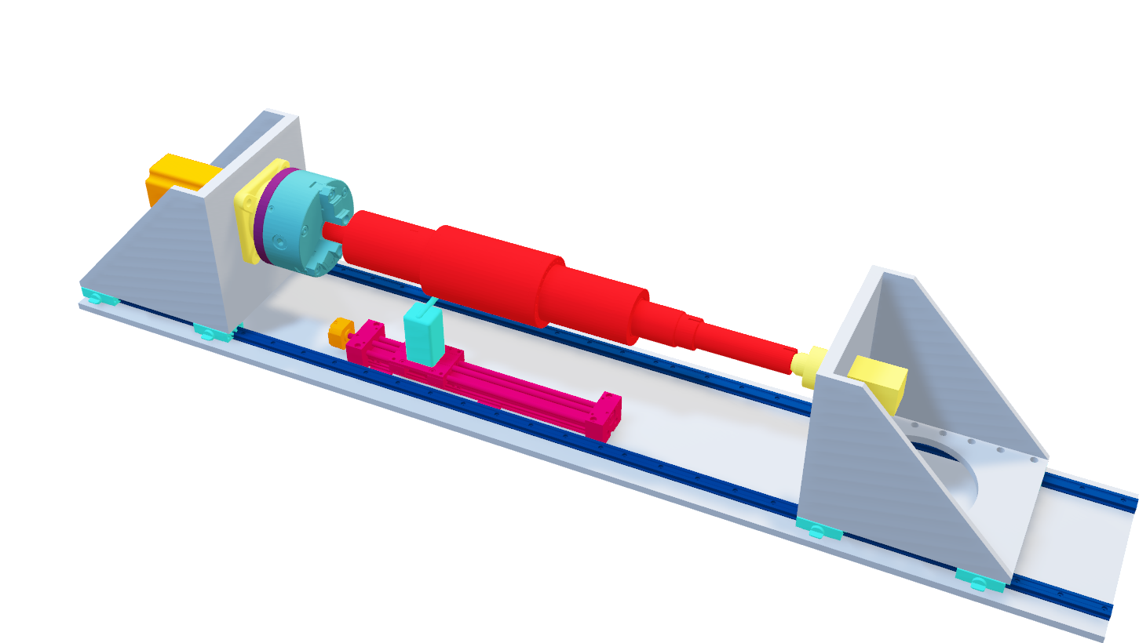
Design Overview
Liora Louis

Slide 10
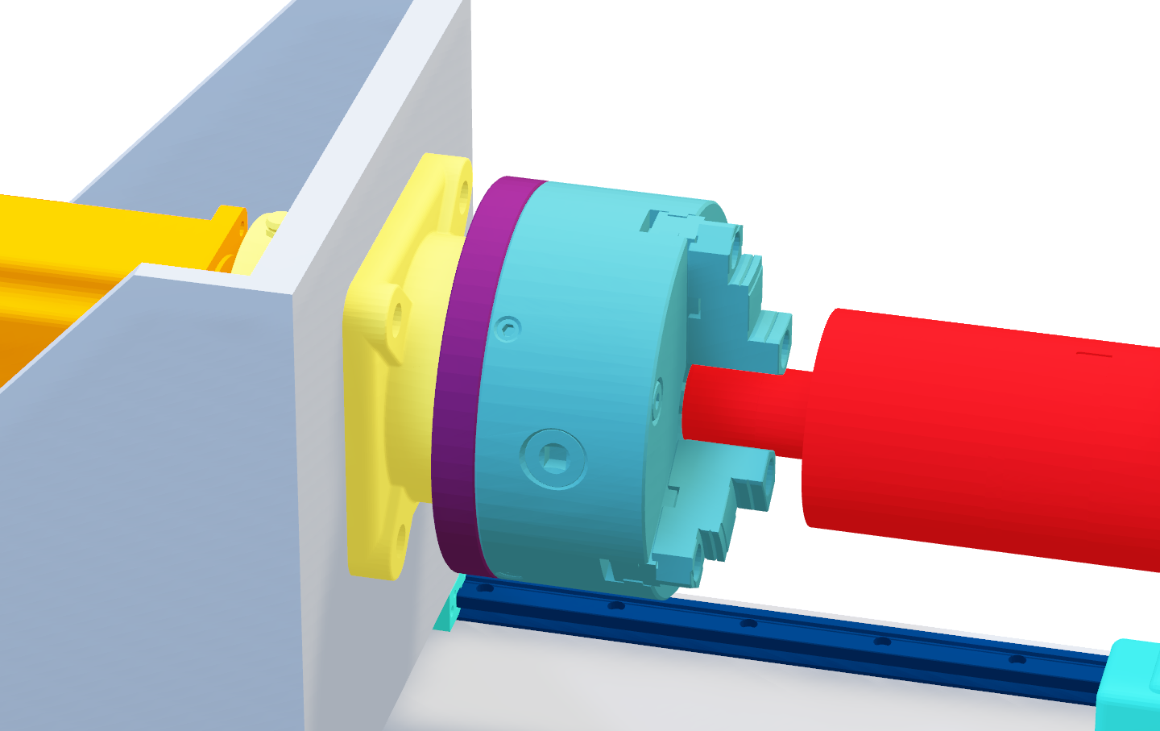
Liora Louis
Rotational System

Slide 11
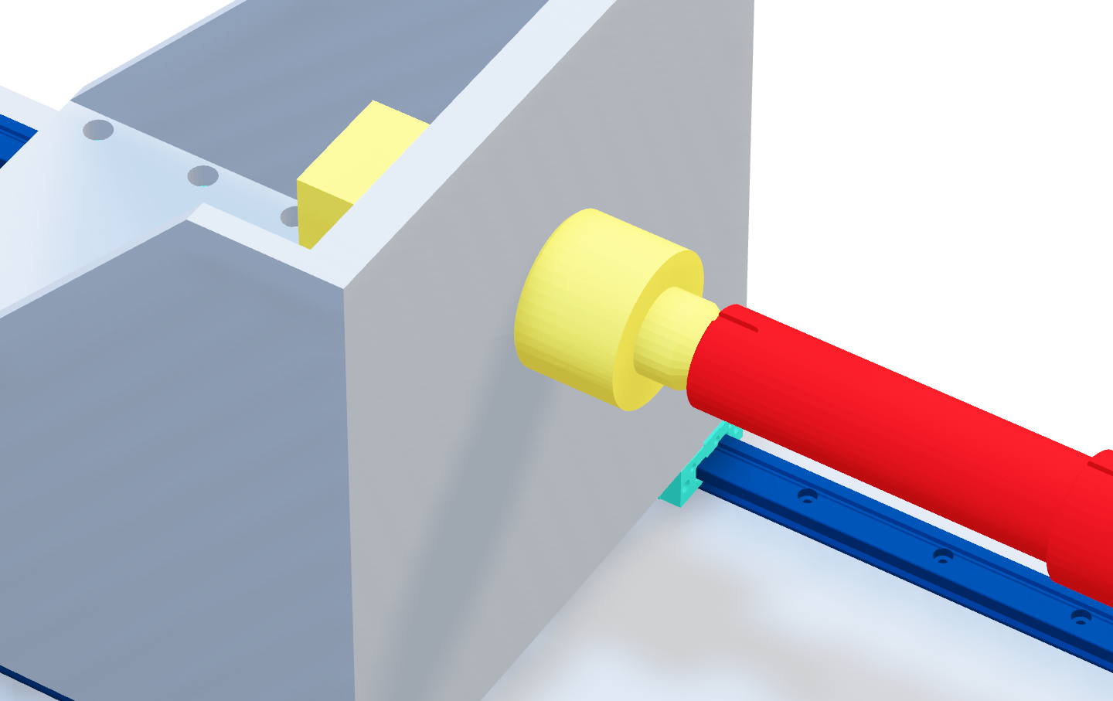
Liora Louis
Rotational System

Slide 12
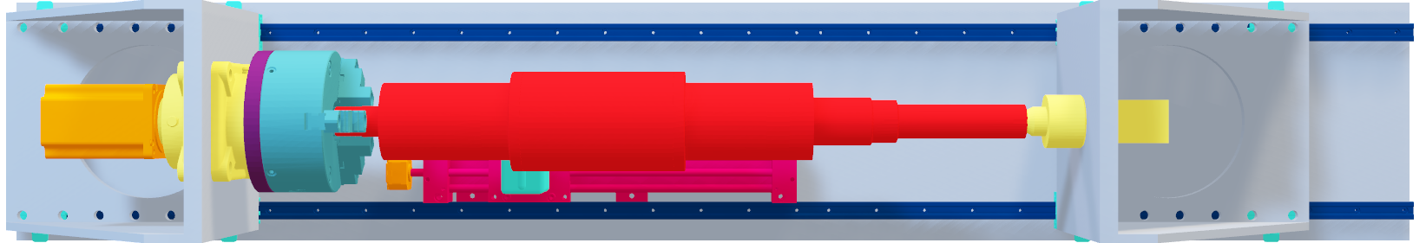
Liora Louis
Linear System

Slide 13
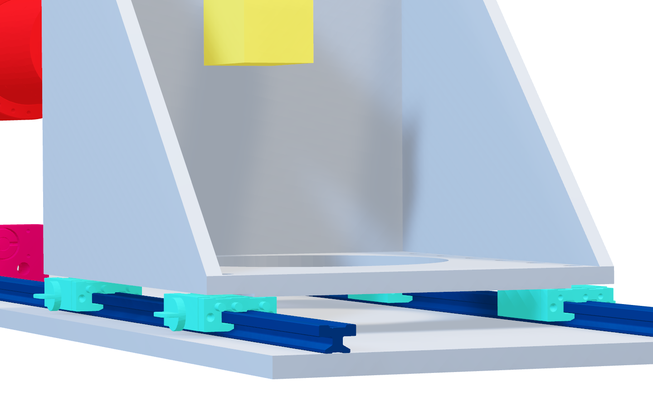
Liora Louis
Linear System

Slide 14
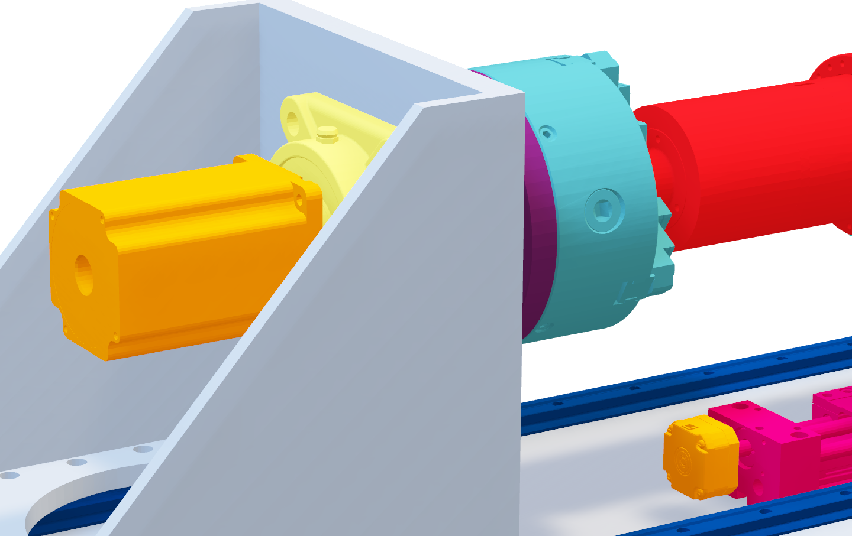
Liora Louis
Electrical System

Slide 15
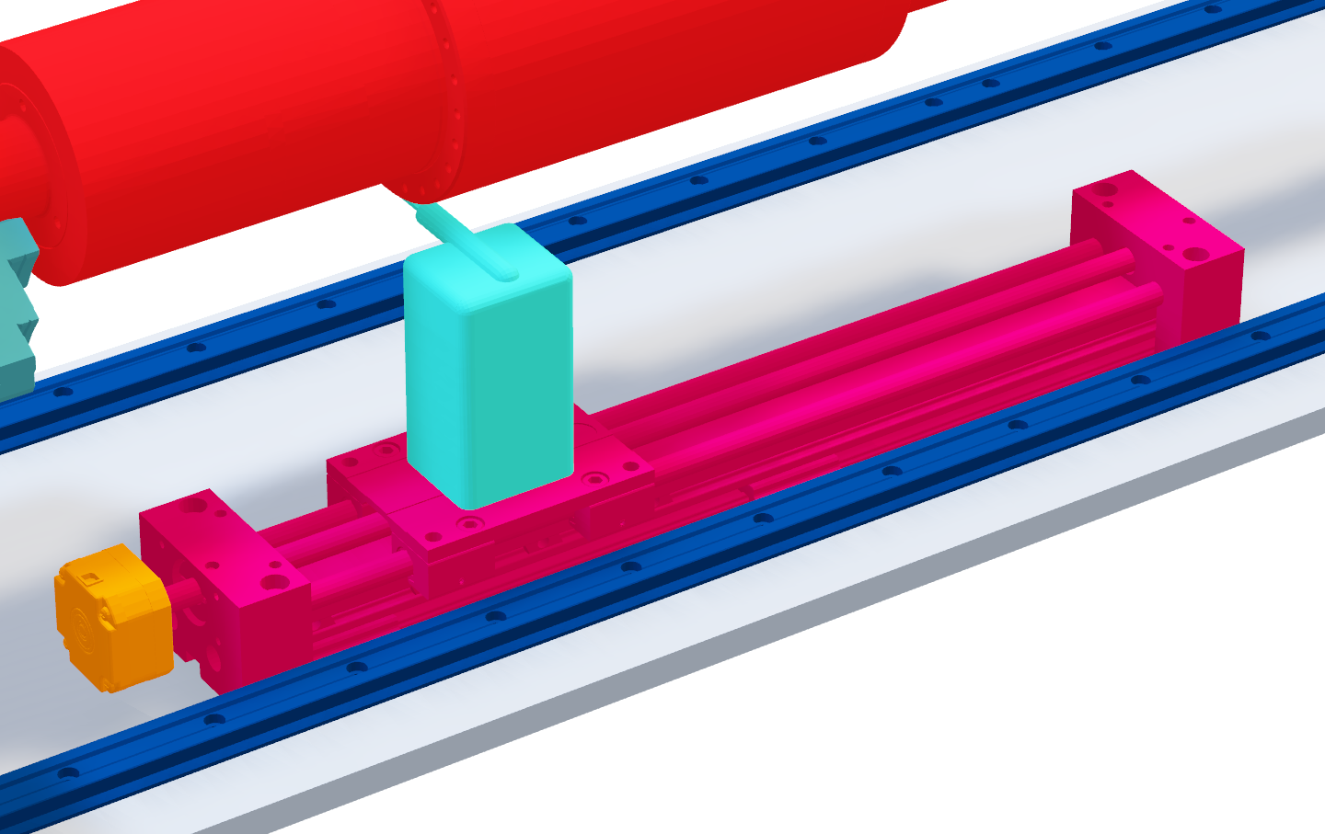
Liora Louis
Linear Actuator

Slide 16
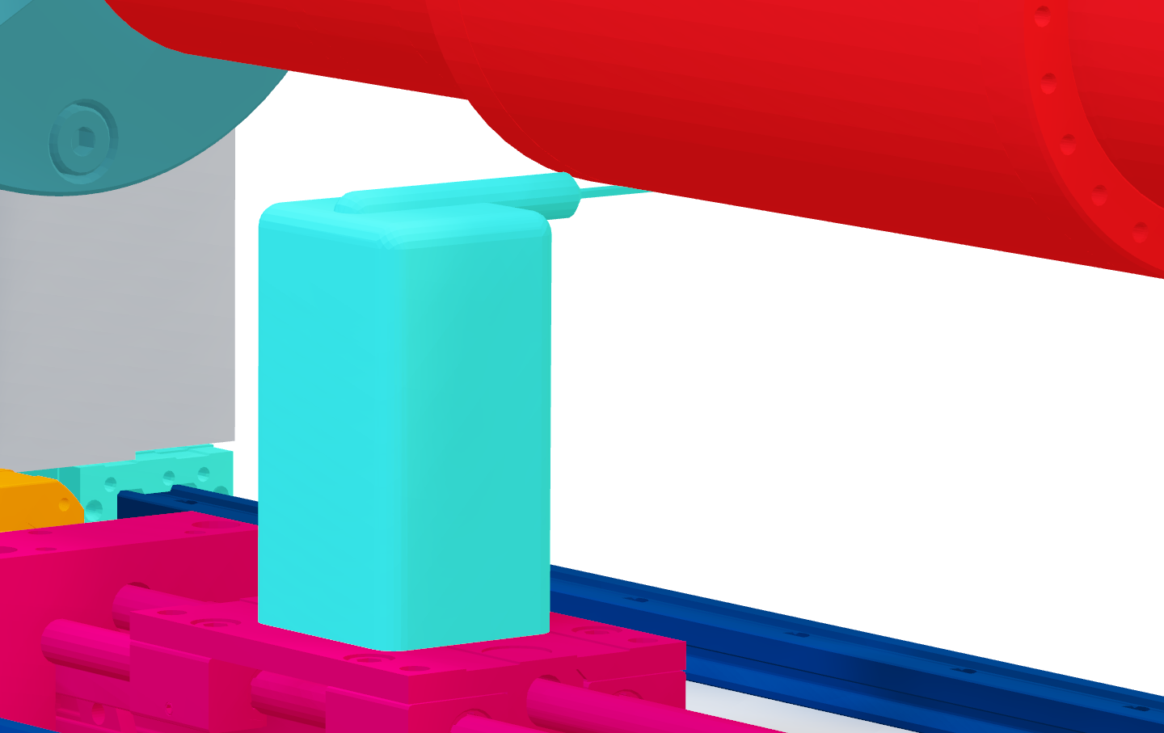
Liora Louis
Flux Meter Probe

Slide 17
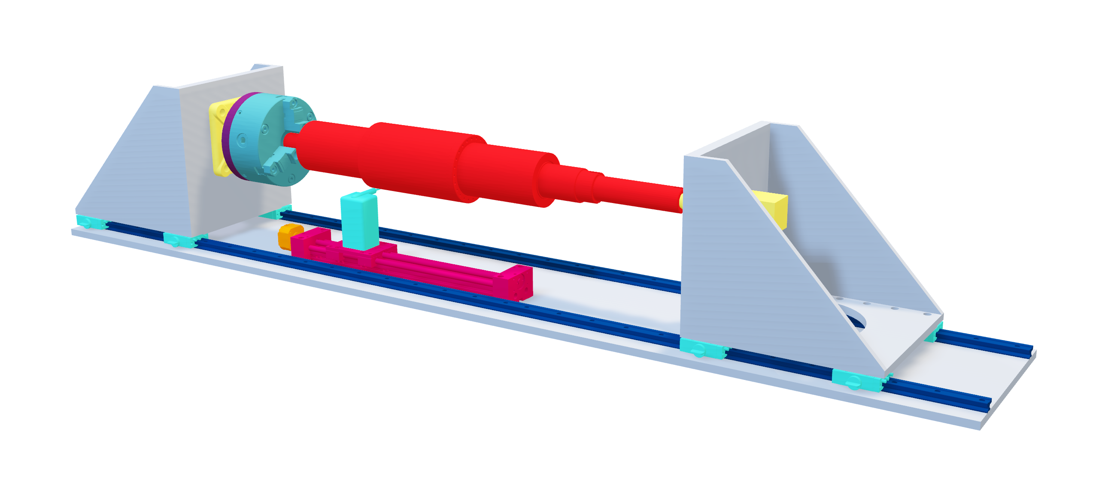
Liora Louis

Slide 18
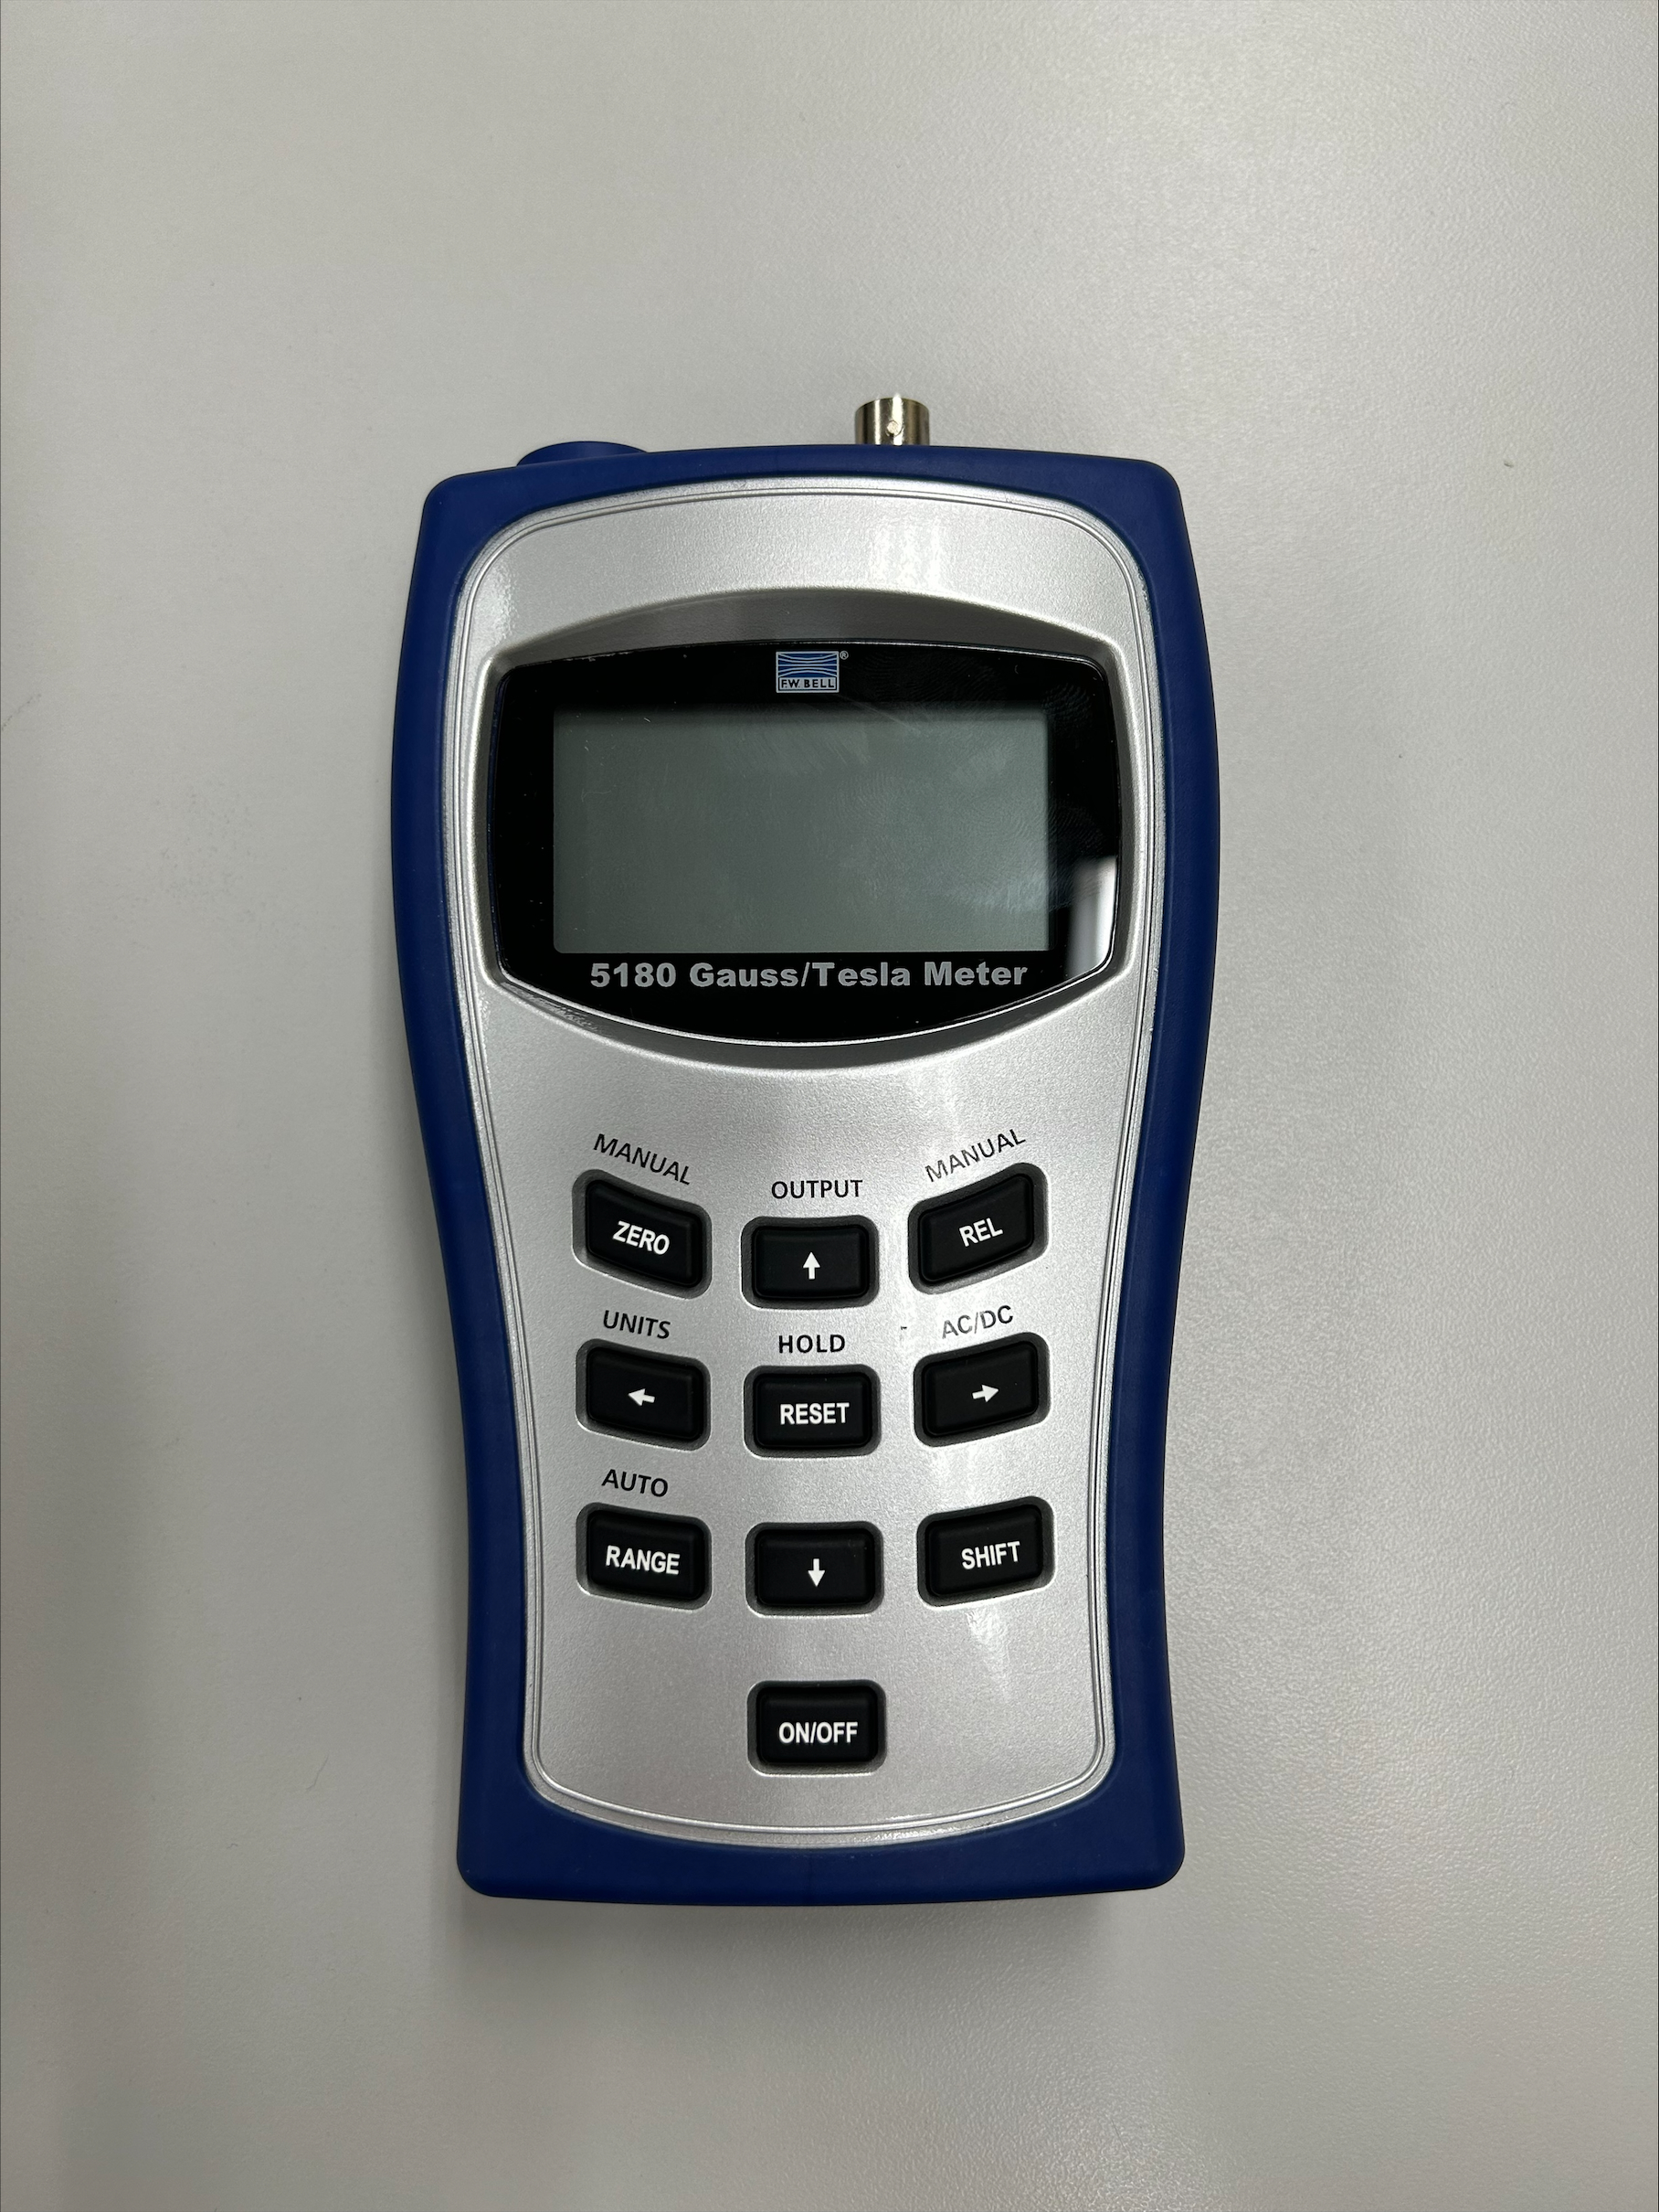
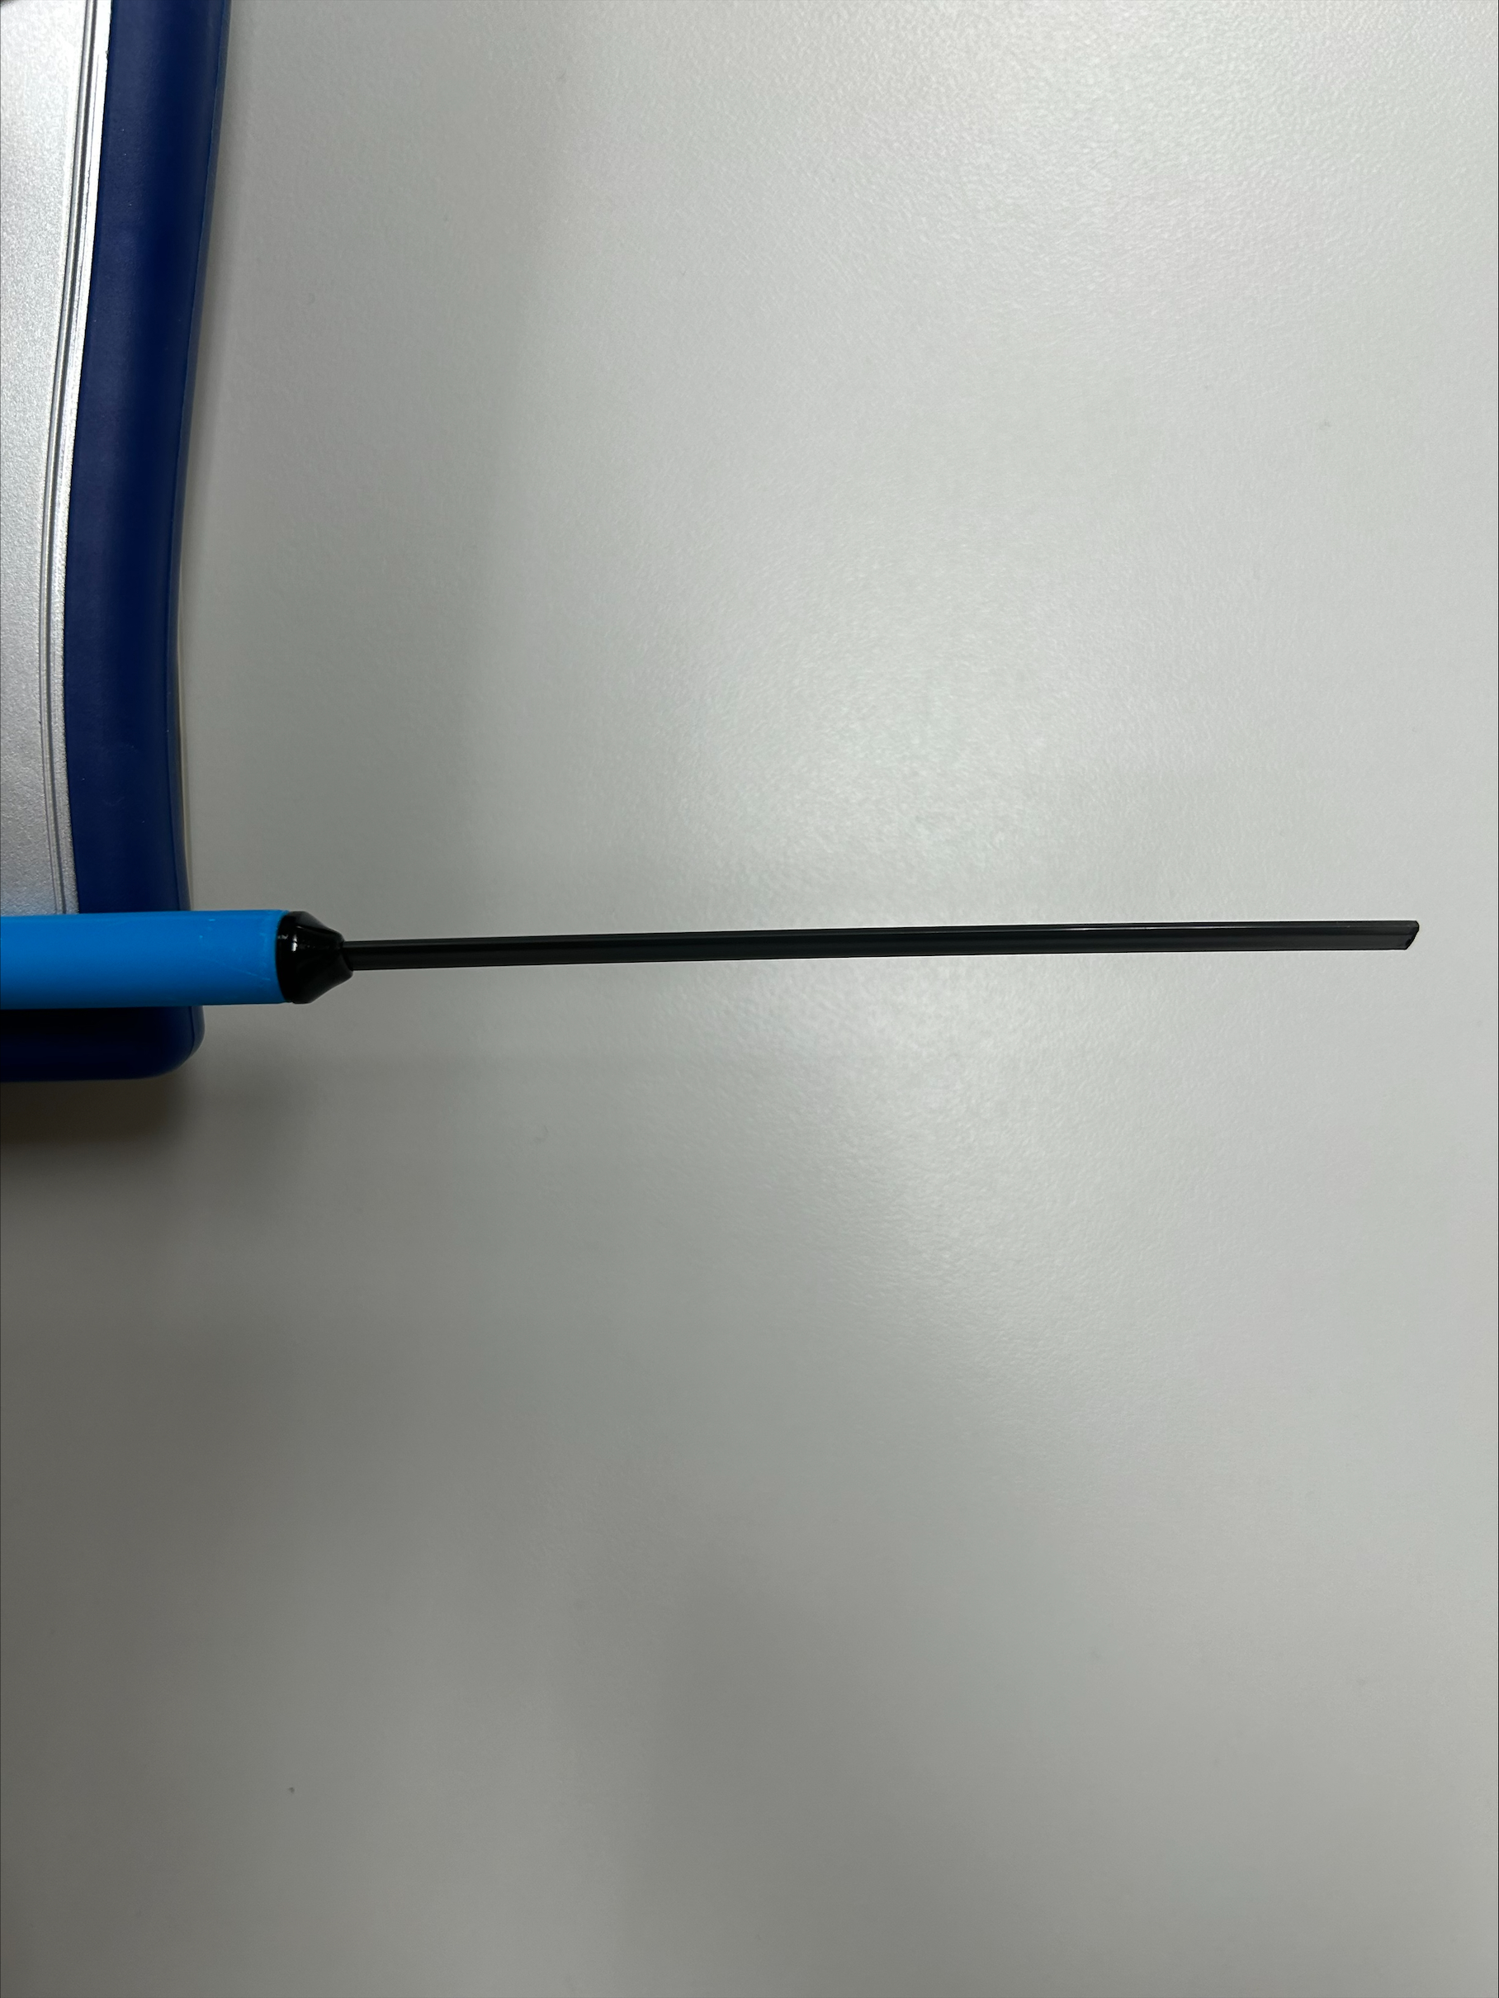
Data Collection
Liora Louis
Fluxmeter can be remotely controlled with a computer
Computer application provided that allows automatic logging
Testing shows sensor probe does NOT need to be in contact with shaft, but it must be close

Slide 19
Path of the Sensor
Liora Louis
The flux meter will take measurements at specified time intervals based on the desired resolution.
Sensor
Circumference
Length

Slide 20



Bill of Materials
Liora Louis
Parts Ordered
Linear Actuator
Mechanical Components
Electronic Components
Notes:
Wood router 4th axis (chuck head, live center, motor with gear belt)

Slide 21




User Operation
Liora Louis
Loading Sample
Verify Level
Set Measurement Parameters
Start

Slide 22



Device Operation
Liora Louis
Motors move probe into position
Fluxmeter reads flux
Data records to Excel table
Data point is plotted on graph

Slide 23
Future Work
Liora Louis
Complete Purchasing
Start Assembly of Device
Begin Coding Arduino
Preliminary Testing

Slide 24
This is 10-point
This is 15–point Times
This is 20–point
This is 25–point
This is 30–point
This is 35–point
This is 40–point
This is 50–point
This is 60–point
This is 72–point
Notes:
Use at least 20-point font in Room A105, B134, and B136
Use at least 25-point font in Room B135

Slide 25
College of Engineering Color Palette
1 2 3 4
Pantone: PMS 195 C
RGB: 120, 47, 64
Hex: #782F40
CMYK:19, 90, 50, 55
1 2 3 4
Pantone: Black C
RGB: 0, 0, 0
Hex: #000000
CMYK:0, 0, 0, 100
Garnet
Black
1 2 3 4
RGB: 238, 118, 36
Hex: #EE7624
CMYK:2, 66, 99, 0
1 2 3 4
Pantone: PMS 000C
RGB: 255, 255, 255
Hex: #FFFFFF
CMYK: 0, 0, 0, 0
Fang
Orange
White
Notes:
Avoid 75% Black in B135

Slide 26
Accent Color Palette
1 2 3 4
RGB: 0, 59, 111
Hex: #003B6F
CMYK:
1 2 3 4
RGB: 0, 59, 111
Hex: #003B6F
CMYK:
1 2 3 4
RGB: 251, 236, 93
Hex: #FBEC5D
CMYK:
1 2 3 4
RGB: 219, 215, 210
Hex: #DBD7D2
CMYK:
1 2 3 4
RGB: 251, 236, 93
Hex: #FBEC5D
CMYK:
1 2 3 4
RGB: 219, 215, 210
Hex: #DBD7D2
CMYK:
Tardis Blue
Tardis Blue
Corn
Timberwolf
Corn
Timberwolf
1 2 3 4
RGB: 206, 0, 88
Hex: #CE0058
CMYK: 0, 100, 43, 12
1 2 3 4
RGB: 206, 0, 88
Hex: #CE0058
CMYK: 0, 100, 43, 12
1 2 3 4
RGB: 104, 40, 96
Hex: #682860
CMYK:
1 2 3 4
RGB: 220, 220, 220
Hex: #DCDCDC
CMYK:
Rubine Red
Rubine Red
Imperial
Gainsboro
1 2 3 4
RGB: 72, 146, 155
Hex: #48929b
CMYK:
1 2 3 4
RGB: 64, 224, 208
Hex: #40E0D0
CMYK:
1 2 3 4
RGB: 255, 139, 0
Hex: #FF8B00
CMYK:
Asagi-iro
Turquoise
American Orange
Notes:
Remove American orange add hyperlink grey
Make corn the last for b135
All work in 134 imperial move later
Tardis doesn’t work in b136

Slide 27
F7AB19
D67F15
EE7624
D64615
F73119
Analogous
https://color.adobe.com/create/color-wheel
6E3610
F0A16C
EE7624
6E4931
BASB1C
Monochromatic
A14508
4BED3B
EE7624
250CED
2010A1
Triad
A1470C
FF8C40
EE7624
0098A1
24E2ED
Complementary
28A164
2FED8D
EE7624
0848A1
1871ED
Split Complementary
EDAC2F
3BED93
EE7624
0C6AED
ED2F18
Double Split Complementary
ED660C
C7ED3B
EE7624
0CE1ED
A418ED
Square
BA7E09
87724A
EE7624
60EFCF
09BA61
Compound
AD551A
6E3610
EE7624
FA7625
D46820
Shades
Notes:
These are the variants that work well with Fang Orange. The bolded items show well on the projectors.

Slide 28
85412D
8F3831
782f40
8F3176
792D85
Analogous
https://color.adobe.com/create/color-wheel
C44D69
8E626D
782F40
C48796
451B25
Monochromatic
C43959
78743B
782F40
236178
43A2C4
Triad
C43959
C46078
782F40
25C43D
2F783A
Complementary
93C460
577835
782F40
39C49D
297861
Split Complementary
784435
5A783B
782F40
237860
6E2978
Double Split Complementary
782337
78683b
782F40
237830
293978
Square
AB4D32
DEBAAF
782F40
5D8555
70AB32
Compound
38161E
C44D69
782F40
853447
5E2532
Shades

Slide 29
A105
A105
B135 Stage Left
B135 Stage Right
B136
B134, A105
B135

